Slide 1
K-means clustering and K Nearest Neighbours
Intro to AI and Text Analytics

Slide 2
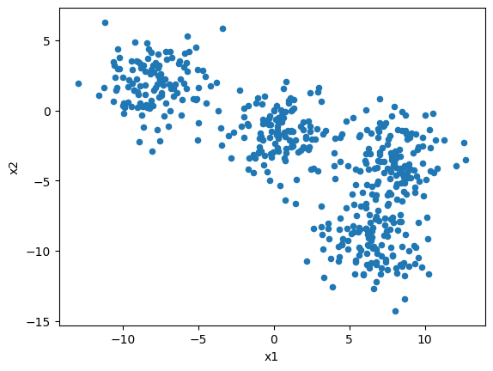
from sklearn.datasets import make_blobs
import pandas as pd
data, true_labels = make_blobs(n_samples=500, centers=4, random_state=6, cluster_std = 1.8)
points = pd.DataFrame(data, columns=["x1", "x2"])
points.plot.scatter("x1", "x2")
Look at this data and discuss with the person next to you:
How many clusters could there be?
How did you work out the answer?
How should you do that process algorithmically (particularly in higher dimensions, where you can’t visualize the data)?

Slide 3
K-means clustering
Input: k – number of clusters (int), data (data frame/array)
Randomly pick k candidates for the initial cluster “centroids” (often picked from your data)
For each point in your dataset:
Calculate its distance to each centroid
Assign the point to the cluster of the “nearest” centroid
For each cluster:
Calculate the mean of all points assigned to the cluster
Update the centroid to this new mean position (this is typically not a point from the data but it exists in the same feature space)
Iterate this process until either:
The centroids stabilise and no longer change much between iterations
You reach some max iteration limit
Output: a cluster label for each data point (int), a cluster centroid for each cluster label (array)

Slide 4
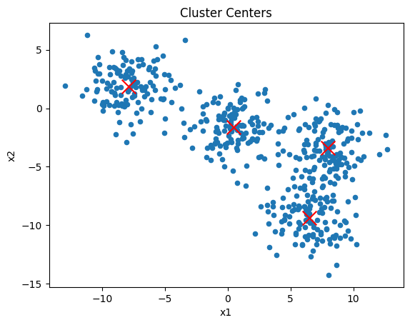
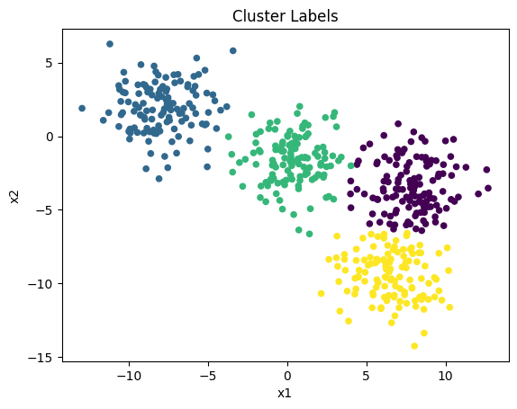

Slide 5
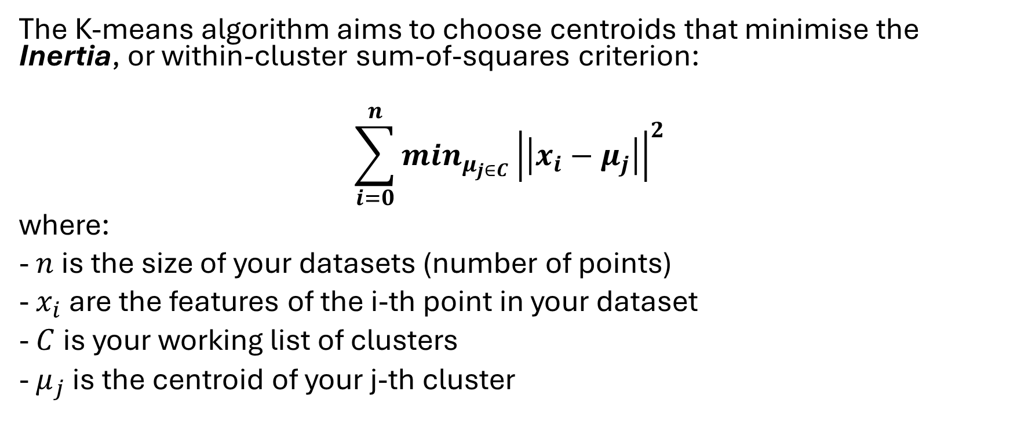
How do we define “nearest?”
The K-means algorithm aims to choose centroids that minimise the Inertia, or within-cluster sum-of-squares criterion:
$$\sum_{i=0}^{n}{\min_{μ_{j∈C}}{\left|\left|x_{i}−μ_{j}\right|\right|}^{2}}$$
where:
- $n$is the size of your datasets (number of points)
- $x_{i}$ are the features of the i-th point in your dataset
- $C$is your working list of clusters
- $μ_{j}$ is the centroid of your j-th cluster

Slide 6
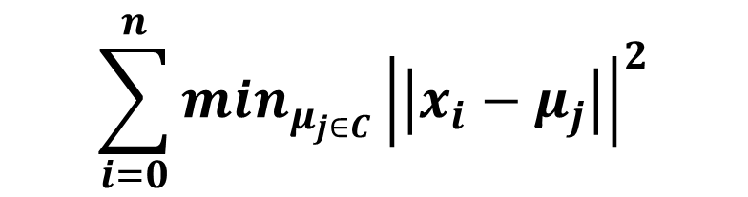
Inertia can be recognised as a measure of how internally coherent clusters are.
What assumptions does Inertia make about the structure of a cluster?
What disadvantages might happen clustering based on inertia if your data is high dimensional?
$$\sum_{i=0}^{n}{\min_{μ_{j∈C}}{\left|\left|x_{i}−μ_{j}\right|\right|}^{2}}$$

Slide 7
Inertia assumes that clusters are:
convex (if you can draw a stright line between any two points within the cluster and the entire line remains inside the cluster) and
isotropic (uniform in all directions, so in our case assuming the clusters are spherical), which is not always the case. It responds poorly to elongated clusters, or manifolds with irregular shapes.
Inertia is not a normalized metric: we just know that lower values are better and zero is optimal. But in very high-dimensional spaces, Euclidean distances tend to become inflated (this is an instance of the so-called “curse of dimensionality”).

Slide 8
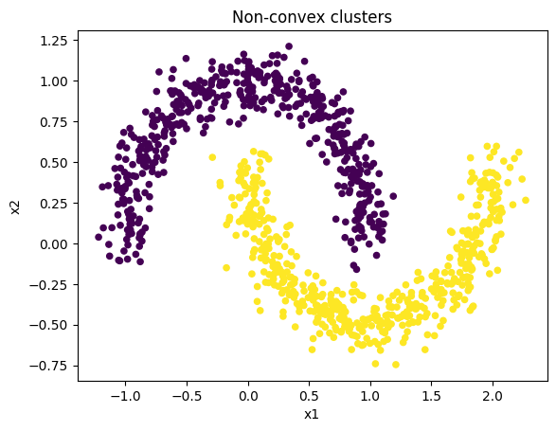
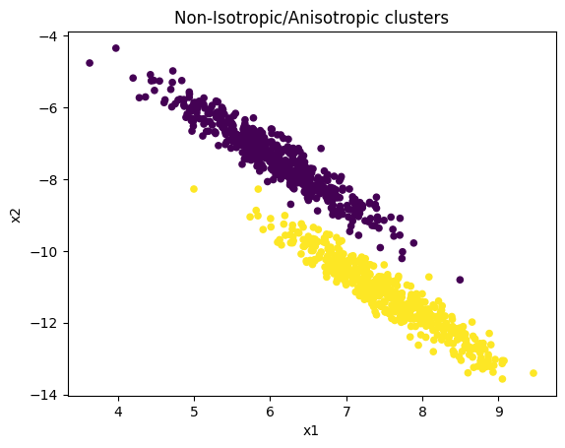
Inertia Assumes that Clusters are:
1. convex (if you can draw a straight line between any two points within the cluster and the entire line remains inside the cluster)
2. isotropic (uniform in all directions, so in our case assuming the clusters are spherical), which is not always the case. It responds poorly to elongated clusters, or manifolds with irregular shapes.

Slide 9
How do you choose “k”?
Being able to choose "k" your number of clusters, is a double edged sword.
When you have external insight (usually contextual knowledge about the data, it's not often likely your data is low enough dimension for you to be able to eyeball clusters) where you want to steer your model, picking a reasonable value of k can be useful.
When you don't have that insight, making a sensible choice for "k" can be tricky! Some other algorithms such as "DBSCAN" do not let you pick a number of clusters.
One method is using something called a “Silhouette Score”

Slide 10
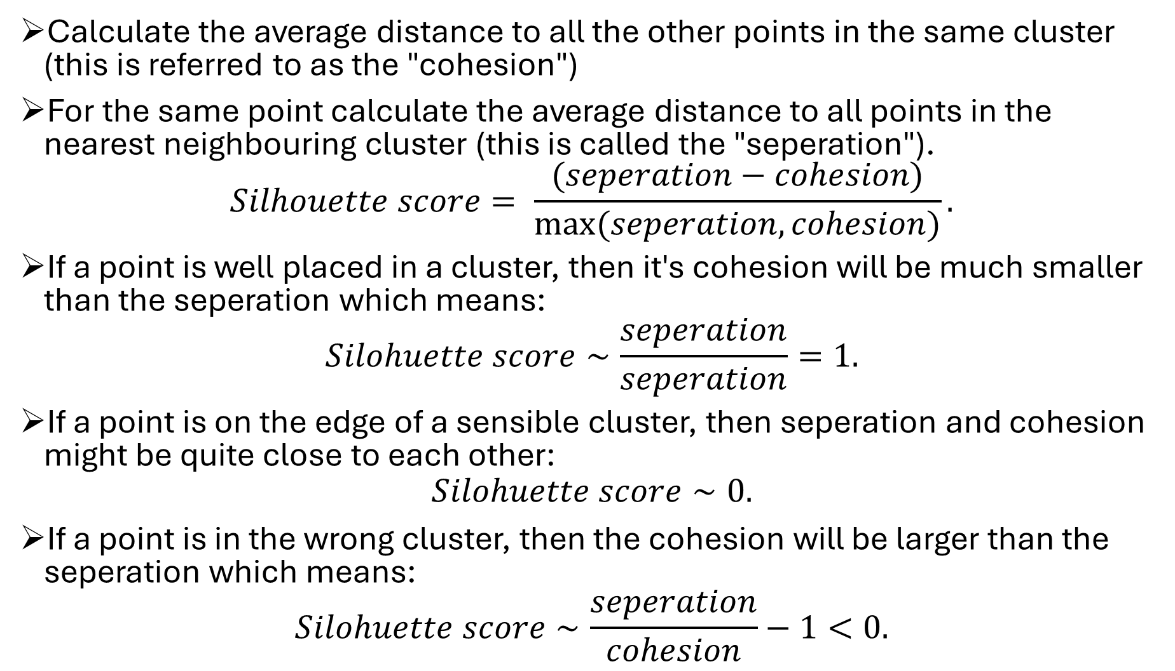
Calculate the average distance to all the other points in the same cluster (this is referred to as the "cohesion")
For the same point calculate the average distance to all points in the nearest neighbouring cluster (this is called the "seperation").
$$Silhouette score= \frac{(seperation−cohesion)}{max⁡(seperation, cohesion)}.$$
If a point is well placed in a cluster, then it's cohesion will be much smaller than the seperation which means:
$$Silohuette score∼\frac{seperation}{seperation}=1.$$
If a point is on the edge of a sensible cluster, then seperation and cohesion might be quite close to each other:
$$Silohuette score∼0.$$
If a point is in the wrong cluster, then the cohesion will be larger than the seperation which means:
$$Silohuette score∼\frac{seperation}{cohesion}−1<0.$$

Slide 11
Any questions on K means clustering?
This tells us how to interpret our score on a given datapoint in a clustering algorithm. To evaluate the score for the entire dataset we take the average silohuette score for every data point.
A score of +1 will only happen for dream datasets that don't exist in the real world. A score of around ~0.7 is excellent and anything around ~0.2 is usually deemed to be poor.
Note this score is clustering algorithm agnostic so can be used to evaluate any clustering algorithm!

Slide 12
Intro to Supervised Learning
Does your data have labels?
Supervised Learning
If your labels are discrete: Classification
If your labels are continuous: Regression
Unsupervised Learning
Dimensionality Reduction, Clustering etc.

Slide 13
Train test split
from sklearn.model_selection import train_test_split
train_X, test_X, train_y, test_y = train_test_split(X, y)
In supervised machine learning, we have data with labels and we want to train a model to predict labels from data.
But we don’t want to just have a model “remember” labels from data, we want our model to perform well on data it hasn’t seen before.
To do this, we split our data into training data and test data. By default this is often a 70:30 split. These two collections are disjoint.
We train our model on the training data and then see how well it generalizes on the test data.

Slide 14
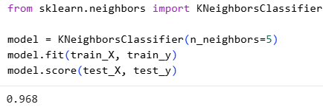
K-Nearest Neighbours Classification
Intuition: “the label of data point is likely to be similar to the labels of the other data points near it”
Value k: how many nearest neighbours do you look at to make that judgement?
An example of “instance-based learning”. There is no internal model constructed (nothing is “learnt”), classification is computed from a majority vote of the nearest neighbours at each point.

Slide 15
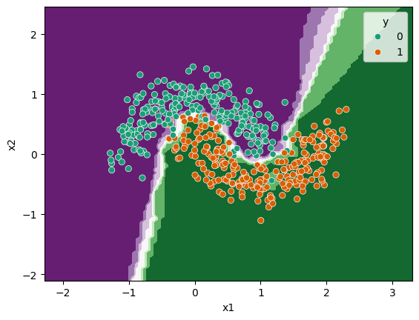
Visualising Decision Boundaries
The optimal value of k is very data-dependent. We can play around with different values of k to see how it affects performance. In general a larger k reduces the effects of noise but makes the classification boundaries less distinct.
We can visualise the decision boundary of our KNN algorithm to see how it makes the decision.
from sklearn.inspection import DecisionBoundaryDisplay
import seaborn as sns
DecisionBoundaryDisplay.from_estimator(model, X, cmap="PRGn")
sns.scatterplot(data=X, x="x1", y="x2", hue=y, palette="Dark2")

Slide 16
The effect of distance
KNN has a “weights” parameter which by default is “uniform” (everyone of the K nearest neighbours has uniform influence on the classification).
You might decide that nearer data points should have a stronger influence on the algorithms decision. Seeting weights = “distance” assigns weights proportional to the inverse of the distance from the query point.
Intuitively, you might only want to pick the nearest k neighbors as long as they are in a certain radius. This modified algorithm is called the Radius Neighbors Classifier.

